Slide 1
OpenDSS Training Workshop
Roger C. Dugan Sr. Technical Executive
SRP/ASU Workshop, Tempe AZ 16-17 Dec 2014

Slide 2
Agenda
Day 1
OpenDSS Concepts
Installation
Basic scripting
The COM interface
Day 2
Loadshapes and Smart Grid Simulation
Detailed Modeling
COM interface example(s)
Misc hints and tips
DA Class Exercise

Slide 3
Objectives of this Workshop
Provide basic training in OpenDSS usage
Provide distribution engineers with a powerful tool for dynamic distribution modeling to supplement their existing tools
Provide students:
With a tool to complete their research
With an understanding of power distribution systems
With skills for the next generation power industry
The “Integrated Grid”
Encourage students to explore and develop new concepts useful to the industry

Slide 4
What is the OpenDSS?
Script-driven, frequency-domain electrical circuit simulation tool for dynamic distribution system modeling
Specific models for:
Supporting utility distribution system analysis
Initially designed for the unbalanced, multi-phase North American power distribution systems
Can also model European-style systems
These typically have a simpler structure

Slide 5
What is the OpenDSS? (cont’d)
Heritage of OpenDSS
Harmonics solvers rather than power flow
Gives OpenDSS extraordinary distribution system modeling capability
Simpler to solve the power flow problem with a harmonics solver than vice-versa
Supports all rms steady-state (i.e., frequency domain) analyses commonly performed for utility distribution system planning
And many new types of analyses
Original purpose in 1997: DG interconnection analysis

Slide 6
What is the OpenDSS? (cont’d)
What it is NOT
An Electromagnetic transients solver (Time Domain)
It can solve Electromechanical transients
Frequency Domain => “Dynamics” mode
All solutions are in phasors (complex math)
Not a “Power Flow” program
Not a radial circuit solver
Does meshed networks with equal ease
Not a distribution data management tool
It is a simulation engine designed to work with data extracted from one or more utility databases

Slide 7
What is the OpenDSS? (cont’d)
EPRI acquired the DSS software from Electrotek Concepts in 2004
It is EPRI’s primary tool for researching new methods in distribution system analysis
EPRI made the program open source in 2008 to collaborate with the industry to advance grid modernization efforts
User have access to the latest versions that EPRI is using
Sourceforge.net is our source code repository

Slide 8
Why Dynamic Distribution Modeling?
You don’t get the right answer for many issues unless you simulate over a significant period of time
Disruptive technologies in distribution systems:
Integration of distributed generation and storage
Microgrids
Electric vehicles and other load changes
Evaluation of power delivery losses

Slide 9
Time- and Location-Dependent Benefits
Traditional distribution system analysis programs
Designed to study peak demand capacity
Capture mostly location-specific benefits
Ignores time; assumes the resource is available
This gets the wrong answer for many DG, energy efficiency, and Smart Grid analyses
Must do sequential-time analysis to get the right answer
Over a distribution planning area
Over a significant time period
Year, Month, or Week

Slide 10
What can OpenDSS be used for?
DG
Interconnection studies/screening
Value of service studies (risk based)
Solar PV voltage rise/fluctuation
Wind power variations impact
Hi-penetration solar PV impacts
Harmonic distortion
Dynamics/islanding

Slide 11
Program Files
For each of X86 and X64 versions:
OpenDSS.EXE Standalone EXE
OpenDSSEngine.DLL In-process COM server
KLUSolve.DLL Sparse matrix solver
DSSView.EXE is a separate program for processing graphics output

Slide 12
User Interfaces Currently Implemented
A stand-alone executable program that provides a text-based scripting interface (multiple windows)
Some graphical output is also provided.
No graphical input is provided.
An in-process COM server (for Windows) that supports driving the simulator from user-written programs.
32-bit and 64-bit (New in 2012)
EPRI Program 174 funders have access to DGScreener, an interface to OpenDSS

Slide 13
Why Scripting and COM?
More flexible than static forms
No two Smart Grid simulations alike
Not possible to predict what users will want to do
COM = Component Object Model
Supported by nearly all programming languages, Microsoft Office, MATLAB, Python, etc
Allows user to write their own algorithms
For things like DA controllers and DMS simulators
Co-simulation of power and communications
COM is not familiar to most power engineers but is powerful means of scripting

Slide 14
What is COM?
COM = Component Object Model
A binary-interface standard for software components introduced by Microsoft in 1993
Related technologies
OLE, OLE Automation, ActiveX, COM+, DCOM
A language-neutral way of implementing objects that can be used in environments different from the one in which they were created
Microsoft Office tools like Excel and Work can be Automated via COM
And VBA supports automating other apps via COM

Slide 15
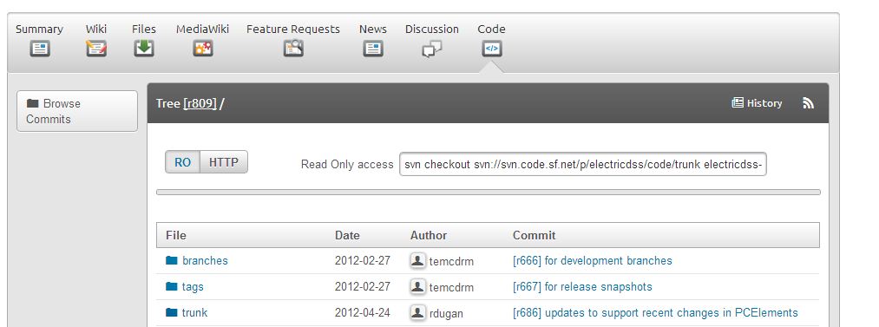
SourceForge.Net Links for OpenDSS
EPRI Links Page
http://smartgrid.epri.com/SimulationTool.aspx
OpenDSS Download Files:
http://sourceforge.net/projects/electricdss/files/
Top level of Main Repository

Slide 16
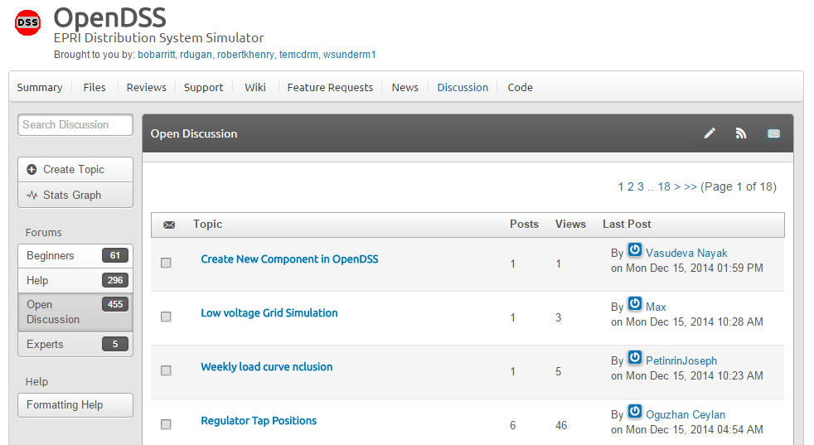
Discussion Forum & News for OpenDSS

Slide 17
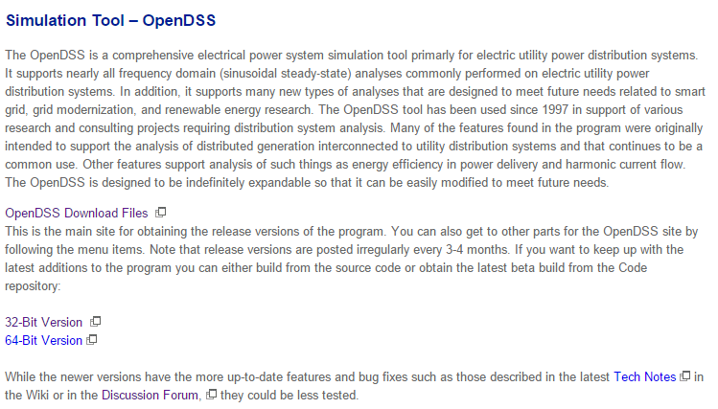
Installing
EPRI Link Page
http://smartgrid.epri.com/SimulationTool.aspx

Slide 18
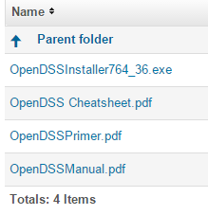
Installing
Download the Installer
http://sourceforge.net/projects/electricdss/files/
Get pdf Files, too (Also can be found in distrib/doc folder)

Slide 19
Registering the COM Server Manually
Registering occurs automatically when using the Installer
If you intend to drive OpenDSS from another program, you will need to register the COM server
Some programs require this !!
If you are sure you will only use OpenDSS.EXE, you can skip this step
You can come back and do it at any time
In the command (cmd) window, change to the folder where you installed it and type:
Regsvr32 OpenDSSEngine.DLL

Slide 20
Manually Registering the COM Server – Windows 7 (Method 1)
Special instructions for Windows 7
(and probably Windows Vista, too)
See Q&A on the Wiki site
http://sourceforge.net/apps/mediawiki/electricdss/index.php?title=How_Do_I_Register_the_COM_Server_DLL_on_Windows_7%3F
All Programs > Accessories
right-click on the Command Prompt and select Run as Administrator.
Then change to your OpenDSS folder and type in
"regsvr32 OpenDSSEngine.DLL”

Slide 21
Registering the COM Server – Windows 7, Method 2
Another Process for Windows 7
per Andy Keane- UC Dublin
1. Right click on the desktop and select new -> shortcut
2. For location of item just type ‘cmd’
3. This will create a new shortcut to a command prompt on your desktop
4. Right click on the new shortcut and select ‘Properties’
5. On the shortcut tab select ‘Advanced’
6. Tick the ‘Run as Administrator’ box
7. Press Apply/OK and that command prompt will always be run as administrator allowing the user to use regsvr32

Slide 22
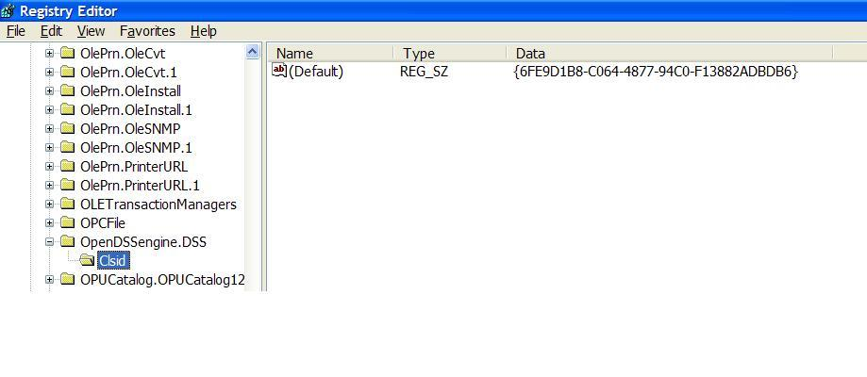
So What Did this Do?
Windows Registry Entry
GUID
The Server shows up as “OpenDSSEngine.DSS” in the Windows Registry
The OpenDSS is now available to any program on the computer
On Windows 7: 32-bit server is registered in WOW6432Node

Slide 23
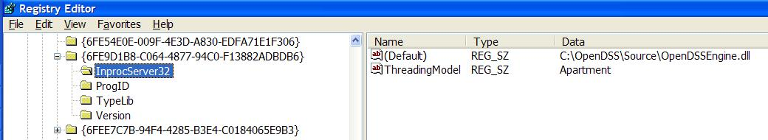
The GUID References the DLL File ….
If you look up the GUID in RegEdit
Points to OpenDSSEngine.DLL (In-process server, Apartment Threading model)

Slide 24
32-bit Vs 64-bit
On Windows 7 & 8 you can register both versions
They are in separate places in the registry
You will probably need to register both
MATLAB is often installed as 64-bit (x64)
MS Office is most often installed as 32-bit (x86)
Windows 7 will run the proper version depending on the type of program invoking the DSSEngine.
Magic!!

Slide 25
32-bit Vs 64-bit
On Windows 7 you can register both versions
They are in separate places in the registry
You will probably need to register both
MATLAB is often installed as 64-bit (x64)
MS Office is most often installed as 32-bit (x86)
Windows 7 will run the proper version depending on the type of program invoking the DSSEngine.
Magic!!

Slide 26
Questions So Far?

Slide 27
How OpenDSS Works

Slide 28
The Math …
Nearly everything results in a matrix or array
Nodal Admittance formulation
Circuit elements modeled by primitive admittance matrices
Y_{prim}
Primitive Y matrices used to build System Y matrix
OpenDSS Works In
Phase domain
Actual volts and amps
Symmetrical components and per units not used inside the program !! -- Input and output only!

Slide 29
Primitive Y Matrix
Simple Resistor

Slide 30
Primitive Y Matrix, cont’d
LINE model

Slide 31
What about 3-phase elements?
Simply let R, X, B, G, C, etc. represent 3x3 matrix
Notation stays the same
And it works!
I1, I2, V1, V2 etc become 3x1 vectors
This is basically how all the Circuit Element (CktElement) models in OpenDSS work.

Slide 32
The Network Model

Slide 33
Nodal Admittance Equations
V₁
V₂
…
V_{S}
…
V_{L1}
…
V_{L2}
…
V_{N}
I₁
I₂
…
I_{S}
…
I_{L1}
…
I_{L2}
…
I_{N}
Y_{SYSTEM}
=
N x N
(Sparse)
N = Number of NODES (not BUSES)

Slide 34
Solving the Power Flow
Once the circuit model is connected properly the next step is to Solve the base power flow
PC elements (i.e., Loads) are usually nonlinear
Loads are linearized to a Norton equivalent based on nominal 100% rated voltage.
Current source is “compensation current”
Compensates for the nonlinear characteristic
A fixed point iterative solution algorithm is employed for most solutions
This method allows for flexible load models and is robust for most distribution systems

Slide 35
Load (a PC Element)
General Concept
Added into Injection Current Vector
Goes into System Y Matrix
(One-Line Diagram)
Most Power Conversion (PC) Elements are Modeled Like This

Slide 36
Load - 3-phase Y connected
Phase 1
1
2
Phase 2
3
4 Conductors/Terminal
Phase 3
4

Slide 37
Load - 3-phase Delta connected
Phase 1
2
1
Phase 2
3
3 Conductors/Terminal
Phase 3

Slide 38
Load Models (Present version)
1:Standard constant P+jQ load. (Default)
2:Constant impedance load.
3:Const P, Quadratic Q (like a motor).
4:Nominal Linear P, Quadratic Q (feeder mix). Use this with CVRfactor.
5:Constant Current Magnitude
6:Const P, Fixed Q
7:Const P, Fixed Impedance Q
8: Special ZIP load model

Slide 39
Standard P + jQ (constant power) Load Model
When the voltage goes out of the normal range for a load the model reverts to a linear load model
This generally guarantees convergence
Even when a fault is applied
This script changes break points to +/- 10%:
Load.Load1.Vmaxpu=1.10
Load.Load1.Vminpu=0.90
Note: to solve some of the IEEE Radial Test feeders and match the published results, you have to set Vminpu to less than the lowest voltage published (usually about 0.80 per unit)

Slide 40
Standard P + jQ Load Model (Model=1)
Const Z
105%
(Defaults*)
95%
|I| = |S/V|
Const Z
New Method (2014)
* Change by setting Vminpu and Vmaxpu Properties

Slide 41
Power Flow Solution Algorithm
Initial Guess at Node Voltages, V
Compute all Injection (Compensation) Currents, I
For PC Elements
Solve for new guess at V
Repeat 2 and 3 until Converged
Convergence is based on change in per unit voltage magnitude
Default tolerance = 0.0001
Good enough for distribution systems

Slide 42
Putting it All Together
ALL Elements
Yprim 1
Yprim 2
Yprim 3
Yprim n
PC Elements Comp. Currents
I1
I2
Y
Node
Voltages
I_{inj}
=
V
Im
Iteration Loop

Slide 43
Putting it All Together
Th-Th-That's All Folks !
ALL Elements
Yprim 1
Yprim 2
Yprim 3
Yprim n
PC Elements Comp. Currents
I1
I2
Y
Node
Voltages
I_{inj}
=
V
Im
Iteration Loop

Slide 44
Solving the Power Flow …
This solution method requires that the first guess at the voltages be close to the final solution
Not a problem for daily or yearly simulations
Present solution is a good guess for next time step
First solution is often most difficult
The solution initialization routine in OpenDSS accomplishes this with ease in most cases
Method works well for arbitrary unbalances
For conditions that are sensitive, a Newton method is provided that is more robust, but slower.
Not to be confused with “Newton-Raphson Power Flow”

Slide 45
Solution Speed
Distribution systems generally converge very well
Many transmission systems, also
The OpenDSS on par with faster commercial programs
Solution method is designed to run annual simulations
Our philosophy:
Err on the side of running more power flow simulations
Don’t worry about the solution time until it proves to be a problem
This reveals more information about the problem

Slide 46
OpenDSS Solution Loop with Controls

Slide 47
Validation of OpenDSS
EPRI routinely checks OpenDSS power flow results against CYME, SYNERGEE, WindMil, and other programs after converting data sets for various projects.
The OpenDSS program has been benchmarked against all the IEEE Test Feeders
(http://ewh.ieee.org/soc/pes/dsacom/testfeeders/).
OpenDSS was used to develop the NEV test feeder and the 8500-node test feeder.
Being used to develop the DG Protection test feeder
For the EPRI Green Circuits project, computed load characteristics were calibrated against measured data.

Slide 48
Circuit Modeling Basics
Some things that might be a bit different than other power system analysis tools you may have used.

Slide 49
DSS Bus Model (Bus ≠ Node)
Nodes
Bus
Referring to Buses and Nodes (A Bus has 1 or more Nodes)
Bus1=BusName.1.2.3.0
(This is the default for a 3-phase circuit element)
Shorthand notation for taking the default
Bus1=BusName
Note: Sometimes this can bite you (e.g. – Transformers, or capacitors with ungrounded neutrals)

Slide 50
DSS Terminal Definition
Conductors
Circuit Elements have one or more Terminals with 1..N conductors.
Conductors connect to Nodes at a Bus
Each Terminal connects to one and only one Bus

Slide 51
Power Delivery Elements
PD Elements are Generally Completely Described by [Yprim]

Slide 52
Power Conversion Elements
I_{Term}(t) = F(V_{Term}, [State], t)
Power Conversion (PC) elements are typically connected in “shunt” with the Power Delivery (PD) elements
PC Elements may be nonlinear
Described some function of V
May be linear
e.g., Vsource, Isource
May have more than one terminal, but typically one
Load, generator, storage, etc.

Slide 53
Specifying Bus Connections
Shorthand (implicit)
New Load.LOAD1 Bus1=LOADBUS
Assumes standard 3-phase connection by default
LOADBUS
6
5
4
3
LOAD
2
1
0

Slide 54
Specifying Bus Connections
Explicit
New Load.LOAD1 Bus1=LOADBUS.1.2.3.0
Explicitly defines which node
New Load.1-PHASELOAD Phases=1 Bus1=LOADBUS.2.0
Connects 1-phase load to Node 2 and ground
1-Phase Load Example

Slide 55
Specifying Bus Connections
Default Bus templates
Node connections assumed if not explicitly declared
Element declared Phases=1
… LOADBUS.1.0.0.0.0.0.0.0.0.0. …
Element declared Phases=2
… LOADBUS.1.2.0.0.0.0.0.0.0.0. …
Element declared Phases=3
… LOADBUS.1.2.3.0.0.0.0.0.0.0. …

Slide 56
Specifying Bus Connections
Ungrounded-Wye Specification
Bus1=LOADBUS.1.2.3.4 (or some other unused Node number)
Voltage at this Node is explicitly computed (just like any other Node)

Slide 57
Possible Gotcha: Specifying Two Ungrounded-Wye Capacitors on Same Bus
MyBus
… Bus1=MyBus.1.2.3 Bus2=MyBus.5.5.5
Neutrals are not connected to each other in this specification!
… Bus1=MyBus Bus2=MyBus.4.4.4

Slide 58
Circuit Element Conductors are Connected to the Nodes of Buses
MyBus
3
2
1
0
. . . Bus2 = MyBus.2.1.3.0 . . .
. . . Bus1 = MyBus . . .
(take the default)
(Explicitly define connections)
DSS Convention: A Terminal can be connected to only one Bus. You can have any number of Nodes at a bus.

Slide 59
Example: Connections for 1-Phase Residential Transformer Used in North America
! Line-to-Neutral Connected 1-phase Center-tapped transformer
New Transformer.Example_1-ph phases=1 Windings=3
! Typical impedances for small transformer with interlaced secondaries
~ Xhl=2.04 Xht=2.04 Xlt=1.36 %noloadloss=.2
! Winding Definitions
~ wdg=1 Bus=Bus1.1.0 kV=7.2 kVA=25 %R=0.6 Conn=wye
~ wdg=2 Bus=Bus2.1.0 kV=0.12 kVA=25 %R=1.2 Conn=wye
~ Wdg=3 Bus=Bus2.0.2 kV=0.12 kVA=25 %R=1.2 Conn=wye
Note: You may use XfmrCode to define a library of transformer definitions that are used repeatedly (like LineCode for Line elements)

Slide 60
All Terminals of a Circuit Element Have Same Number of Conductors
3-Phase Transformer

Slide 61
Scripting Basics
Syntax and how to build circuit models.
Simple Model

Slide 62
Scripting Recommendation
A good text editor is recommended
Notepad is OK but others may be better for you:
EditPlus
TextPad
Notepad++
Must be capable of saving a file in plain ANSI text
Not Unicode
Not RTF (Write)
Not Doc (Word)

Slide 63
Scripting
OpenDSS is a scriptable solution engine
Scripts
Series of commands
From text files
From edit forms in OpenDSS.EXE
From another program through COM interface
e. g., This is how you would do looping
Scripts define circuits
Scripts control solution of circuits
Scripts specify output, etc.

Slide 64
Command Syntax
Command parm1, parm2 parm3 parm 4 ….
Parameters may be positional or named (tagged).
If named, an "=" sign is expected.
Name=value (this is the named form)
Value (value alone in positional form)
For example, the following two commands are equivalent:
New Object="Line.First Line" Bus1=b1240 Bus2=32 LineCode=336ACSR, …
New “Line.First Line”, b1240 32 336ACSR, …
Comma or white space

Slide 65
Delimiters
Array or string delimiter pairs: [ ] , { },( ),“ “,‘ ‘
Matrix row delimiter: |
Value delimiters: , (comma) any white space (tab or space)
Class, Object, Bus, or Node delimiter: . (period)
Keyword / value separator: =
Continuation of previous line: ~ (More)
Comment line: //
In-line comment: !
Query a property: ?

Slide 66
Array and Matrix Parameters
Array
kvs = [115, 6.6, 22]
kvas=[20000 16000 16000]
Matrix
(3x3 matrix)
Xmatrix=[1.2 .3 .3 | .3 1.2 3 | .3 .3 1.2]
(3x3 matrix – lower triangle)
Xmatrix=[ 1.2 | .3 1.2 | .3 .3 1.2 ]

Slide 67
An Example

Slide 68
A Basic Script (Class Exercise)
New Circuit.Simple ! Creates voltage source (Vsource.Source)
Edit Vsource.Source BasekV=115 pu=1.05 ISC3=3000 ISC1=2500 !Define source V and Z
New Transformer.TR1 Buses=[SourceBus, Sub_Bus] Conns=[Delta Wye] kVs= [115 12.47]
~ kVAs=[20000 20000] XHL=10
New Linecode.336ACSR R1=0.058 X1=.1206 R0=.1784 X0=.4047 C1=3.4 C0=1.6 Units=kft
New Line.LINE1 Bus1=Sub_Bus Bus2=LoadBus Linecode=336ACSR Length=1 Units=Mi
New Load.LOAD1 Bus1=LoadBus kV=12.47 kW=1000 PF=.95
Solve
Show Voltages
Show Currents
Show Powers kVA elements

Slide 69
Circuit
New Circuit.Simple ! (Vsource.Source is active circuit element)
Edit Vsource.Source BasekV=115 pu=1.05 ISC3=3000 ISC1=2500
Vsource.Source
SourceBus
Source
115
kV
Short Circuit Impedance (a matrix) that yields 3000A 3-ph fault current and 2500A 1-ph fault current.
115 kV, 1.05 pu
One-Line Diagram (default is 3-phase wye-grd source)

Slide 70
Vsource Element Note
Vsource is actually a Two-terminal Device
2nd terminal defaults to connected to ground (0V)
But you can connect it between any two buses
Comes in handy sometimes
Conceptually a Thevinen equivalent
Short circuit equivalent
Actually converted to a Norton equivalent internally

Slide 71
20 MVA Substation Transformer
SourceBus
TR
1
Sub_Bus
Defining Using Arrays
Defining Winding by Winding
New Transformer.TR1 Phases=3 Windings=2
~ Buses=[SourceBus, Sub_Bus]
~ Conns=[Delta Wye]
~ kVs= [115 12.47]
~ kVAs=[20000 20000]
~ XHL=10
New Transformer.TR1 Phases=3 Windings=2 XHL=10
~ wdg=1 bus=SourceBus Conn=Delta kV=115 kVA=20000
~ wdg=2 bus= Sub_Bus Conn=wye kV=12.47 kVA=20000

Slide 72
The Line
Sub_Bus
LoadBus
LINE
1
1
Mile
,
336
New Linecode.336ACSR R1=0.058 X1=.1206 R0=.1784 X0=.4047 C1=3.4 C0=1.6 Units=kft
New Line.LINE1 Bus1=Sub_Bus Bus2=LoadBus Linecode=336ACSR Length=1 Units=Mi
Line objects may also be defined by Geometry or matrix properties.
(Rmatrix=… Xmatrix=… Cmatrix=…)

Slide 73
The Load
Loadbus
LOAD
1
1000
kW
0
.
95
PF
New Load.LOAD1 Bus1=LoadBus kV=12.47 kW=1000 PF=.95
For 3-phase loads, use L-L kV and total kW
For 1-phase loads, typically use L-N kV and total kW unless L-L-connected; Then use L-L kV.

Slide 74
Solving and Showing Results Reports
Solve
Show summary (power flow summary)
Show Voltages
Show Currents
Show Powers kVA elements
Also
Export … (creates CSV files)
Plot …

Slide 75
Detailed Distribution Circuit Modeling
How to organize scripts for larger problems
Examination of how the IEEE 8500-Node Test Feeder model is organized

Slide 76
Scripting Large Circuits
For small circuits, often put all the scripts in one file
Some IEEE test feeder examples are mostly in one file
When you have large amounts of data, a more disciplined approach is recommended using multiple files:
Redirect Command
Redirects the input to another file
Returns to home directory
Compile Command
Same as Redirect except repositions home directory

Slide 77
Organizing Your Main Screen
OpenDSS.exe saves all windows on the main screen
They appear where you left them when you shut down
The next time you start up, you can resume your work
Values are saved in the Windows Registry
Come up with a way you are comfortable with

Slide 78
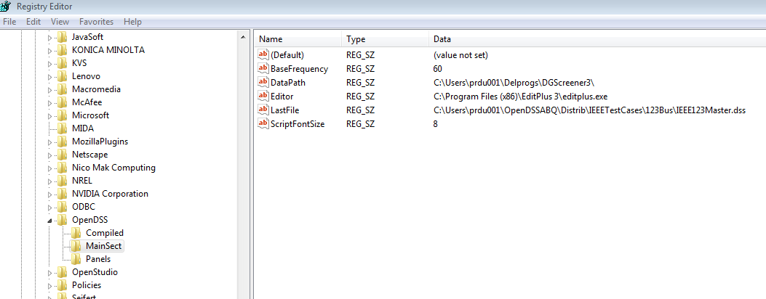
OpenDSS Registry Entries
Certain persistent values are saved to the Windows Registry upon exiting the program
Default Editor Setting

Slide 79
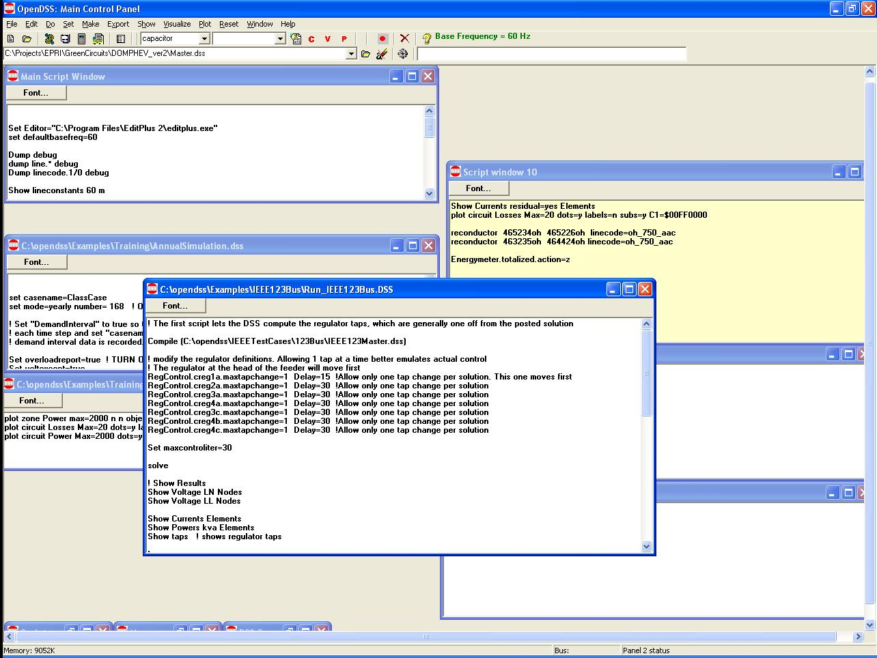
Organizing Your Main Screen
Main Script Window never goes away. Put some frequently-used commands here.
Annual Simulation Script
Misc. Scripts
Plotting Scripts
Project Run window

Slide 80
A Common Sense Structuring of Script Files
Run_The_Master.DSS
“Compile” the Master file from here
Master.DSS
LineCodes.DSS
WireData.DSS
LineGeometry.DSS
Libraries
Put a “Clear” in here
Spectrum.DSS
LoadShape.DSS
Transformers.DSS
Lines.DSS
Circuit Definition
Make a separate folder for each circuit
Loads.DSS
Etc.

Slide 81
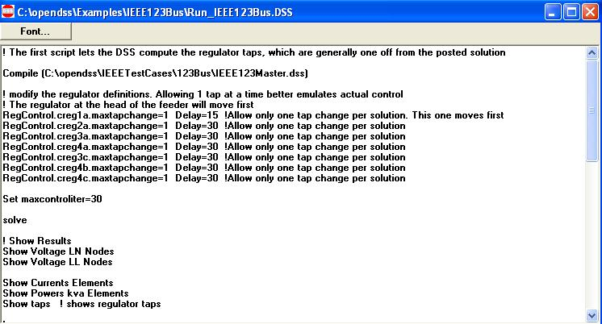
Organizing Run Scripts
Based on 123-bus Test Feeder
Compiles the Circuit Description
Override Some Property Settings and/or Define Some Additional Circuit Element
Change an option
Solve Snapshot Power Flow
Selected Results Display

Slide 82
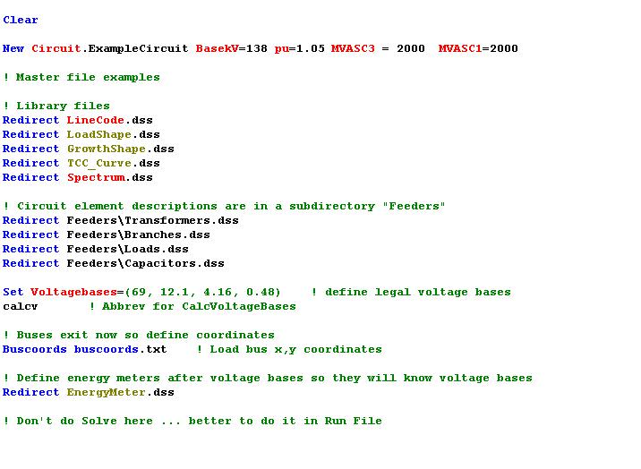
Organizing Your Master File
So Compile Doesn’t Fail
General Library Data
Circuit Elements for this Model
Let OpenDSS Define the Voltage Bases
(You can do this explicitly with SetkVBase command)

Slide 83
Example: IEEE 8500-Node Test Feeder

Slide 84
Main Part of “Run” File
Compile base circuit description
Add an energymeter not in base description
Change an option
Solve
Compile (C:\DSSdata\IEEETest\8500Node\Master-unbal.dss)
! Put an Energymeter at the head of the feeder New Energymeter.m1 Line.ln5815900-1 1
! Sometimes the solution takes more than the default 15 iterations Set Maxiterations=20
Solve

Slide 85
The Master File
Clear
New Circuit.IEEE8500u
! Make the source stiff with small impedance
~ pu=1.05 r1=0 x1=0.001 r0=0 x0=0.001
Redirect LineCodes2.dss
Redirect Triplex_Linecodes.dss
Redirect Lines.dss
Redirect Transformers.dss
Redirect LoadXfmrs.dss ! Load Transformers
Redirect Triplex_Lines.dss
Redirect UnbalancedLoads.dss
Redirect Capacitors.dss
Redirect CapControls.dss
Redirect Regulators.dss
! Let DSS estimate the voltage bases
Set voltagebases=[115, 12.47, 0.48, 0.208]
Calcvoltagebases ! This also establishes the bus list
! Load in bus coordintes now that bus list is established
Buscoords Buscoords.dss

Slide 86
Loadshapes and Smart Grid Simulation
How to use the OpenDSS Loadshape capability and simulate various time-series phenomena related to Smart Grid simulations.

Slide 87
Loadshapes
Key feature of OpenDSS
Efficient execution of time-varying loads, generation is accomplished through Loadshape objects
Sequential time simulation is required for many Smart Grid analyses
Basic time-varying modes that use Loadshape objects
Daily (nominally 24 h, 1 h steps)
Yearly (nominally 8760 h, 1 h steps)
Dutycycle (nominal step size 1 s .. 5 m)
(used for wind and solar)
Learning to work with Loadshapes is an essential skill for OpenDSS users

Slide 88
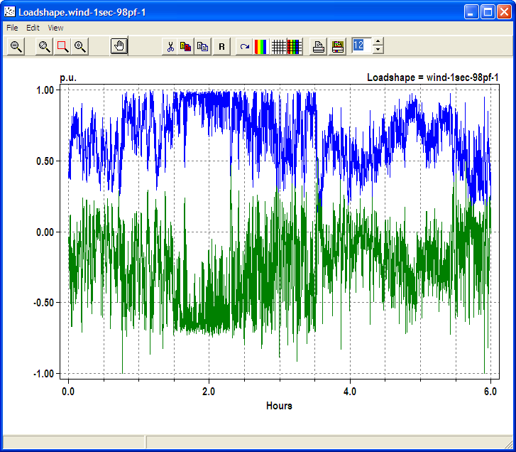
Example Loadshape for Wind Turbine Output
Watts
Vars

Slide 89
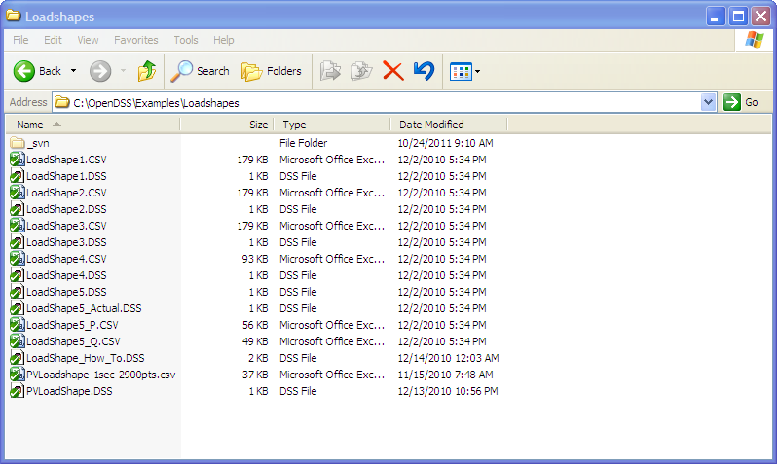
Example Loadshapes Provided in Examples Folder

Slide 90
How to Define
Clear
! Example scripts for loading and plotting loadshapes out of the loadshape library
! You have to have a circuit defined to load in loadshapes.
New Circuit.LoadshapeExamples
! directly ...
New "LoadShape.LoadShape1a" npts=8760 interval=1.0 mult=(File=LoadShape1.csv)
Plot Loadshape Object=Loadshape1a ! execute this to prove you got it
! or using Redirect
Redirect Loadshape1.DSS ! Load in Loadshape 1
Plot Loadshape Object=Loadshape1

Slide 91
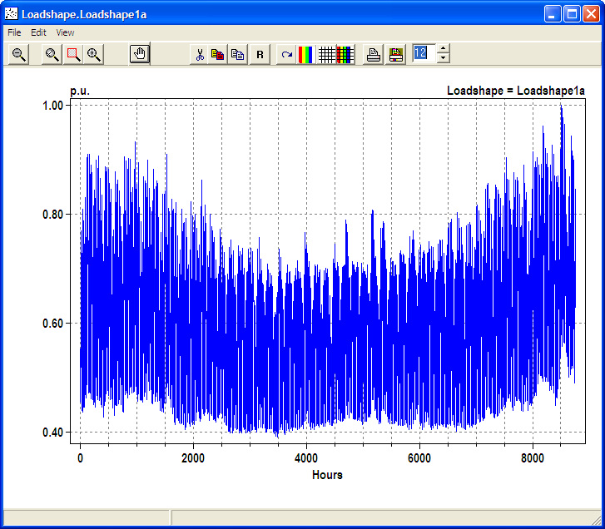
Example Yearly LoadShape

Slide 92
Loadshape Interpolation
The OpenDSS LOADSHAPE class uses two different types of interpolation depending on it is defined
Fixed interval data.
Default: INTERVAL property defaults to 1 hour.
You can set it to another value or to 0.
The SINTERVAL and MINTERVAL properties facilitate defining intervals in Seconds or Minutes.
INTERVAL > 0 means fixed interval data
CSV files --one numeric value per line.
Value REMAINS CONSTANT over the entire interval
The HOUR array property is ignored

Slide 93
Loadshape Interpolation, Cont’d
For LINEAR INTERPOLATION between the points, define INTERVAL=0.
Then both the time and multiplier values for the loadshape using the HOUR, MULT, and QMULT array properties.
Alternatively, you may use the CSVFILE, DBLFILE, or SNGFILE properties.
Enter both the time in hours and the multiplier values.
A CSV file would have two values per line separated by a comma or whitespace.
The variable interval interpolation could be a little bit slower than the fixed interval data because there is more work to do to compute the factor.

Slide 94
Importing Packed Binary Files
For simulations, such as AMI, required large volumes of Loadshapes to be imported, using packed binary files can save time
Standard CSV or TXT file
Mult=[file=myfile.txt]
File of doubles
Mult=[dblfile=myfile.dbl]
File of singles
Mult=[sngfile=myfile.sng]

Slide 95
Recent (2011) Enhancements to Defining Array Properties Using CSV files
Syntax:
mult=[File=myMultiColumnFile.CSV, Column=n, Header=Yes/No]
Allows use of multicolumn CSV files
with a single header row.
Example:
New Loadshape.Ramp2 npts=4000 sInterval=1 mult=(file=MultiChannelTest.csv, column=3, header=yes)
Imports the 3rd column from the file, skipping the header row

Slide 96
OpenDSS COM Interface
Programming via the COM interface

Slide 97
Review: Two Implementations of OpenDSS
Stand-alone EXE
32-bit
64-bit
Use this to develop text scripts to study problems
In-Process COM Server
32-bit
64-bit
Use this to link OpenDSS to other programs
Automate the program
Execute complex algorithms

Slide 98
DSS Structure
Text
Scripts
Main Simulation Engine
COM Interface
User-Written DLLs
Scripts, Results

Slide 99
OpenDSSEngine.DSS is Registered
Windows Registry Entry
GUID
The Server shows up as “OpenDSSEngine.DSS” in the Windows Registry
The OpenDSS is now available to any program on the computer

Slide 100
Linking Your Program to the COM Server
Examples of accessing the COM server in various languages
In MATLAB:
DSSobj = actxserver(‘OpenDSSEngine.DSS’);
In VBA:
Public DSSobj As OpenDSSEngine.DSS Set DSSobj = New OpenDSSEngine.DSS
In Dephi
{Import Type Library}
Type DSSObj : IDSS;
…
DSSObj := coDSS.Create;

Slide 101
Linking Your Program to the COM Server, 2
In PYTHON:
Import win32com.client
Class DSS:
self.engine = win32com.client.Dispatch("OpenDSSEngine.DSS")
In C#:
(Project >Add Reference … select OpenDSSEngine)
Using OpenDSSEngine;
Public DSS DSSObj;
DSSObj = new DSS();

Slide 102
OpenDSS COM Interfaces
There are many interfaces supplied by the COM server
There is one registered In-Process COM interface:
OpenDSSEngine.DSS
The DSS interface is the one your program instantiates
The DSS interface then creates all the others.
This is for simplicity for users who are not necessarily familiar with COM programming

Slide 103
“Active objects” concept
.The interfaces generally act on the ACTIVE object
Active circuit,
Active circuit element,
Active bus, etc.
The interfaces generally point to the active object
To work with another object, change the active object
There are methods for selecting objects
You may also use script commands

Slide 104
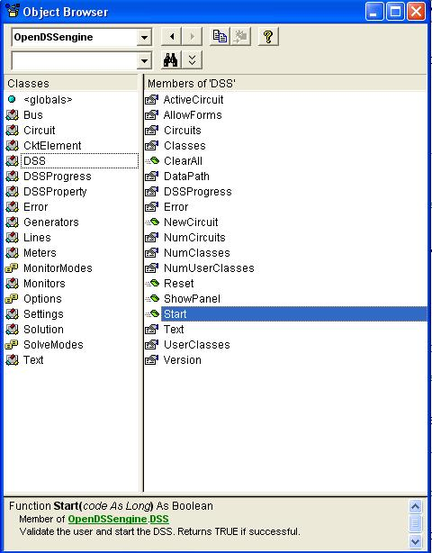
DSS Interface
This is the main interface. It is instantiated upon loading OpenDSSEngine.DSS and then instantiates all other interfaces internally
Call the Start(0) method to initialize the DSS
DSS Class Functions (methods) and Properties

Slide 105
A Simple VBA Macro (Class Exercise)
To run the IEEE 123-bus Test Feeder and plot the voltage profile

Slide 106
Option Explicit
Public MyOpenDSS As OpenDSSengine.DSS
Public MyText As OpenDSSengine.Text
Public MyCircuit As OpenDSSengine.Circuit
Public Sub MyMacro()
Set MyOpenDSS = New OpenDSSengine.DSS
MyOpenDSS.Start (0)
Set MyText = MyOpenDSS.Text
Set MyCircuit = MyOpenDSS.ActiveCircuit
MyText.Command = "Compile (C:\OpenDSS\IEEETestCases\123Bus\IEEE123Master.dss)"
MyText.Command = "New Energymeter.M1 element=Line.L115 terminal=1"
MyText.Command = "Solve"
Dim MyVoltages As Variant
Dim MyNames As Variant
Dim Mydistances As Variant
MyVoltages = MyCircuit.AllBusVmagPu
MyNames = MyCircuit.AllNodeNames
Mydistances = MyCircuit.AllNodeDistances
Dim i As Integer, irow As Integer
irow = 1
For i = LBound(MyVoltages) To UBound(MyVoltages)
ActiveSheet.Cells(irow, 1).Value = MyNames(i)
ActiveSheet.Cells(irow, 2).Value = Mydistances(i)
ActiveSheet.Cells(irow, 3).Value = MyVoltages(i)
irow = irow + 1
Next I
Set MyOpenDSS = Nothing
End Sub

Slide 107
Steps Required to Do This
Register OpenDSSEngine.DLL (32-bit)
Start Microsoft Excel
Type alt-F11 to open VBA editor
Or Tools>Macro …
Select OpenDSS Engine under Tools>References
Insert>Module
Enter the VBA code into blank module
Use correct path name for your computer
Execute the macro “MyMacro”

Slide 108
Resulting Chart in Excel

Slide 109
VBA Example
Option Explicit
Public DSSobj As OpenDSSengine.DSS
Public DSSText As OpenDSSengine.Text
Public DSSCircuit As OpenDSSengine.Circuit
Public Sub StartDSS()
' Create a new instance of the DSS
Set DSSobj = New OpenDSSengine.DSS
' Assign a variable to the Text interface for easier access
Set DSSText = DSSobj.Text
' Start the DSS
If Not DSSobj.Start(0) Then MsgBox "DSS Failed to Start"
End Sub
Define some public variables that are used throughout the project
This routine instantiates the DSS and starts it. It is also a good idea at this time to assign the text interface variable.

Slide 110
VBA Example
Public Sub LoadCircuit(fname As String)
' Always a good idea to clear the DSS when loading a new circuit
DSSText.Command = "clear"
' Compile the script in the file listed under "fname" cell on the main form
DSSText.Command = "compile " + fname
' The Compile command sets the current directory the that of the file
' Thats where all the result files will end up.
' Assign a variable to the Circuit interface for easier access
Set DSSCircuit = DSSobj.ActiveCircuit
End Sub
This subroutine loads the circuit from the base script files using the Compile command through the Text interface. “fname” is a string contains the name of the master file.
There is an active circuit now, so assign the DSSCircuit variable.

Slide 111
VBA Example
Public Sub LoadSeqVoltages()
' This Sub loads the sequence voltages onto Sheet1 starting in Row 2
Dim DSSBus As OpenDSSengine.Bus
Dim iRow As Long, iCol As Long, i As Long, j As Long
Dim V As Variant
Dim WorkingSheet As Worksheet
Set WorkingSheet = Sheet1 'set to Sheet1 (target sheet)
iRow = 2
For i = 1 To DSSCircuit.NumBuses ' Cycle through all buses
Set DSSBus = DSSCircuit.Buses(i) ' Set ith bus active
' Bus name goes into Column 1
WorkingSheet.Cells(iRow, 1).Value = DSSCircuit.ActiveBus.Name
' Load sequence voltage magnitudes of active bus into variant array
V = DSSBus.SeqVoltages
' Put the variant array values into Cells
' Use Lbound and UBound because you don't know the actual range
iCol = 2
For j = LBound(V) To UBound(V)
WorkingSheet.Cells(iRow, iCol).Value = V(j)
iCol = iCol + 1
Next j
iRow = iRow + 1
Next i
End Sub
This Sub puts the sequence voltage onto a spreadsheet
Define a variable for the Bus interface
Define a variant to pick up the arrays
Cycle through all the buses
Get the bus name
Get the voltages into the variant array
Put them on the spreadsheet

Slide 112
Harmonic Solution

Slide 113
Solving for Harmonic Flows
The OpenDSS solution algorithm heritage
McGraw-Edison Steady-State Analysis Program (MESSAP) 1977-78
McGraw-Edison Harmonic Analysis Program (MEHAP) 1979-1982
McGraw/Cooper V-Harm® program (1984)
Electrotek Concepts SuperHarm® program (1990-92)
Electrotek DSS (1997)
Harmonic solution has been an integral part of the program since its inception

Slide 114
Harmonic Solution
All Load elements have ‘Spectrum=default’
The default spectrum is a typical 3-phase ASD spectrum
Re-define Spectrum.Default if you want something else
Edit spectrum.default …
Or create a new Spectrum and assign Loads to it
Harmonic solution requires a converged power flow solution to initialize all the harmonic sources
Do “Solve mode=direct” if convergence is difficult to achieve

Slide 115
Typical Harmonic Solution Script
Typical script for Harmonics Solution
Solve ! Snapshot power flow
Solve mode=harmonics
This will solve for all frequencies defined in the problem
Make sure you have Monitors where you want to see results because results will come fast!
Post process Monitor data in Excel, Matlab, etc. to compute THD, etc.

Slide 116
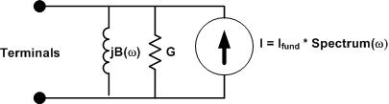
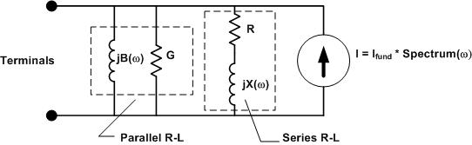
Load Modeling for Harmonics Studies
Original Model
Present Model

Slide 117
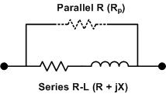
Transformer Modeling
There is now (7.6.3.14) an option to hold X/R Constant
More appropriate for substation transformer
Distribution transformers have lower X/R
Modeling with Reactor
Frequency dependence is coming … Here!
R Curve (XYCurve object)
L Curve

Slide 118
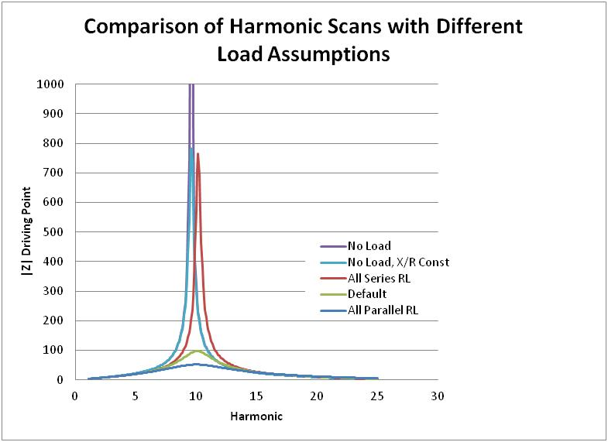
What Difference Does it Make?

Slide 119
Harmonic Solution Mode
Solve the power flow (fundamental frequency)
Harmonic current sources in LOAD models are initialized to match the fundamental frequency solution
Generators converted to Thevenin voltage behind Xd”
“Solve Mode=Harmonics”
Program solves at each frequency that is defined
Non-iterative (direct solution)
Harmonic currents assumed invariant
Y matrix is rebuilt for each frequency
Need MONITOR objects to capture results

Slide 120
Harmonic Solution Mode, Cont’d
Frequency Scans
Define a scan spectrum at a small frequency increment
Assign it to an ISOURCE or VSOURCE
You probably want do disable LOAD and GENERATOR harmonic spectra, e.g.:
Spectrum.DefaultLoad.NumHarm=1
Otherwise, LOAD objects will inject a current at integer harmonic frequencies yielding a really weird solution
Scans can be performed for (see ScanType property)
Positive sequence
Zero sequence
No sequence
Example Frequency Scan
…\Distrib\Examples\FreqScan folder

Slide 121
Frequency Scan Example Script
// THIS SCRIPT WILL RUN A FREQUENCY SCAN ON THE IEEE 123 BUS TEST CASE
Spectrum.DefaultLoad.NumHarm=1 ! This effectively gets rid of LOAD harmonics
// Define a spectrum for the scan source
New spectrum.Scanspec numharm=1000 csvfile=ScanSpectrum.csv
// Put a Monitor to capture the results
New Monitor.Mscan Line.l84 1
// Define a positive-sequence (the default) 1-A, 3-ph current source
New Isource.scansource bus1=83 amps=1 spectrum=scanspec
solve ! solve the power flow at fundamental
solve mode=harmonics ! do the harmonic solutions
show mon mscan ! show the results
Export monitors mscan
// You can plot the Monitor, but Excel or Matlab might be better
Plot monitor object= mscan channels=(1 3 5 )

Slide 122
What Does the Scan Spectrum Look Like?
1.083333333 100 0
1.166666667 100 0
1.25 100 0
1.333333333 100 0
1.416666667 100 0
1.5 100 0
1.583333333 100 0
1.666666667 100 0
1.75 100 0
1.833333333 100 0
1.916666667 100 0
2 100 0
2.083333333 100 0
2.166666667 100 0
2.25 100 0
2.333333333 100 0
2.416666667 100 0
2.5 100 0
2.583333333 100 0
… etc …
% Magnitude
(All 100%)
Harmonic
For 60 Hz base frequency, this gives a 5 Hz scan
Phase Angle
(All 0)
This is typically associated with a 1-A current source, so that the resulting voltages represent driving-point Z, transfer Z, etc.

Slide 123
What Difference Does it Make?

Slide 124
Putting it All Together - Harmonics
ALL Elements, each frequency
Yprim 1
Yprim 2
Yprim 3
Yprim n
PC Elements Harmonic injection Currents
I1
I2
Y
Node
Voltages
(each Frequency)
I_{inj}
=
V
Im

Slide 125
Dynamics Solution

Slide 126
Dynamics Mode
Dynamics mode is used for
Fault current calculations including Generator contributions
Single time-step solution
Machine transients
Inverter transients
Typical time step: 0.2 – 1 ms
Depends on time constants in model
A converged power flow is required to initialize the model.

Slide 127
Basic Algorithm (From SolutionAlgs.Pas)
Increment_time;
{Predictor}
IterationFlag := 0;
IntegratePCStates;
SolveSnap;
{Corrector}
IterationFlag := 1;
IntegratePCStates;
SolveSnap;

Slide 128
Entering Dynamics Mode
Initialize state variables in all PC Elements
For example, in a Generator object currently:
Compute voltage, E₁, behind Xd‘ and Initialize the phase angle, θ, to match power flow (approximately)
Set derivatives of the state variables to zero
For the Generator: Speed (relative to synch frequency), Angle
Set controlmode=time
When running in time steps of a few seconds or less, controls that depend on the control queue for instructions on delayed actions will be automatically sequenced when the solution time reaches the designated time for an action to occur.

Slide 129
3-Phase Generator Model in Dynamics Mode
E∠θ

Slide 130
Differential Equations for Default Generator (1-Mass)
Derivative Calculation:
Integration
Trapezoidal integration formula for θ, for example:

Slide 131
User-Written DLLs
More complex behaviors can be modeled using Dynamic-Linked Libraries
Requires more sophisticated programming skills
Certain PCElements provide interfaces
Some Control elements, too
There is some documentation in the Doc folder, but it is limited
IndMach012 is an example supplied with the program
A symmetrical component based induction machine model for the Generator class element

Slide 132
Running from MATLAB

Slide 133
Running OpenDSS From Matlab
Starting the DSS
%Start up the DSS
[DSSStartOK, DSSObj, DSSText] = DSSStartup;
function [Start,Obj,Text] = DSSStartup
% Function for starting up the DSS
%
%instantiate the DSS Object
Obj = actxserver('OpenDSSEngine.DSS');
%
%Start the DSS. Only needs to be executed the first time w/in a
%Matlab session
Start = Obj.Start(0);
% Define the text interface to return
Text = Obj.Text;

Slide 134
Using the DSS through the Text Interface from Matlab (harmonics example)
%Compile the DSS circuit script
DSSText.Command = 'compile master.dss';
% get an interface to the active circuit called "DSSCircuit"
DSSCircuit = DSSObj.ActiveCircuit;
%Determine which connection type for the source and call
%appropriate DSS file
switch XFMRType
case 1
DSSText.Command = 'redirect directconnectsource.DSS';
case 2
DSSText.Command = 'redirect deltadelta.DSS';
case 3
DSSText.Command = 'redirect deltawye.DSS';
otherwise
disp('Unknown source Connection Type')
end
%Set the system frequency and vsource frequency for harmonic requested
DSSText.Command = ['set frequency=(' num2str(Freq) ' 60 *)'];
DSSText.Command = ['vsource.source.frequency=(' num2str(Freq) ' 60 *)'];

Slide 135
Using the DSS through the Text Interface from Matlab (harmonics example) (cont’d)
% Vary the parameters according to a random distribution
% If more parameters need to be varied, just add them to the below
% list. Set ParamNum to total number of parameters varied
ParamNum = 6; %ParamNum used for sorting/plotting
for Case_Count = 1:Max_Cases
%Create index in the OutputData matrix to keep the cases in order
OutputData(Case_Count,1) = Case_Count;
% Generate random new coordinates for each conductor
[x1 y1 x2 y2 x3 y3 geomean] = RandomGeometry(8,0.75,30);
(... etc. etc. )
%define a new line geometry with random spacing
DSSText.Command = ['New LineGeometry.OHMOD nconds=3 nphases=3 cond=1 wire=acsr336 x=' num2str(x1) ' ' num2str(y1) ' units=ft cond=2 wire=acsr336 x=' num2str(x2) ' ' num2str(y2) ' units=ft cond=3 wire=acsr336 x=' num2str(x3) ' ' num2str(y3) ' units=ft'];
%Solve the circuit
DSSText.Command = 'solve';
(etc. etc.)

Slide 136
Running with Python
See Python Example in Examples Folder …

Slide 137
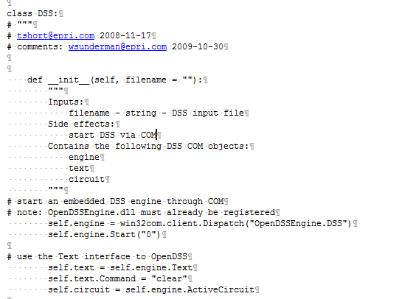
Invoking DSS on IEEE 123 Bus Case

Slide 138
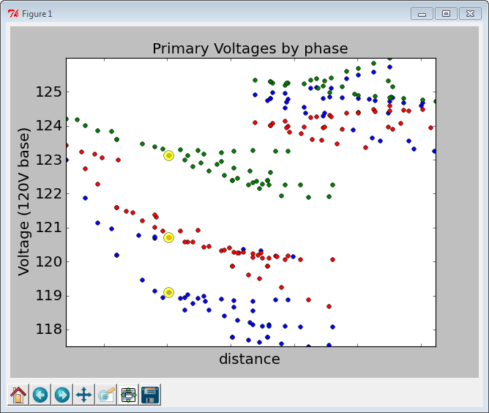
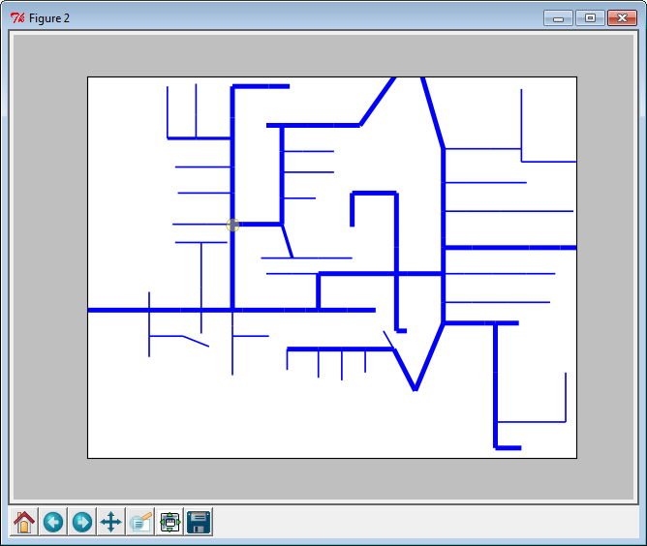
Python Example

Slide 139
Running From C#
Using Visual Studio 2013 Express Version

Slide 140
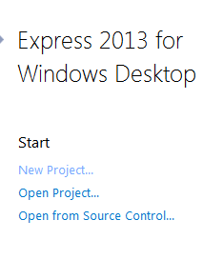
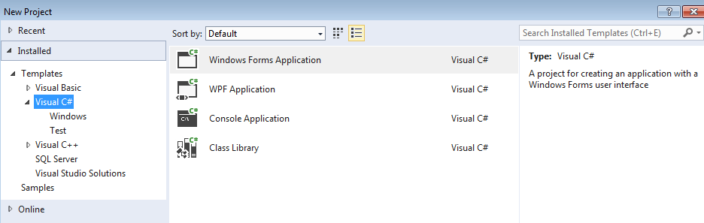
Create a New Visual C# Project …

Slide 141
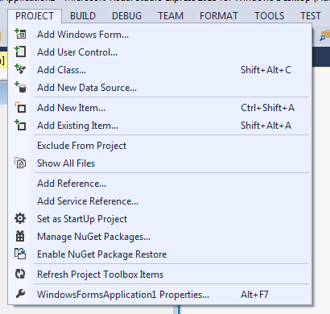
Select Project > Add Reference …

Slide 142
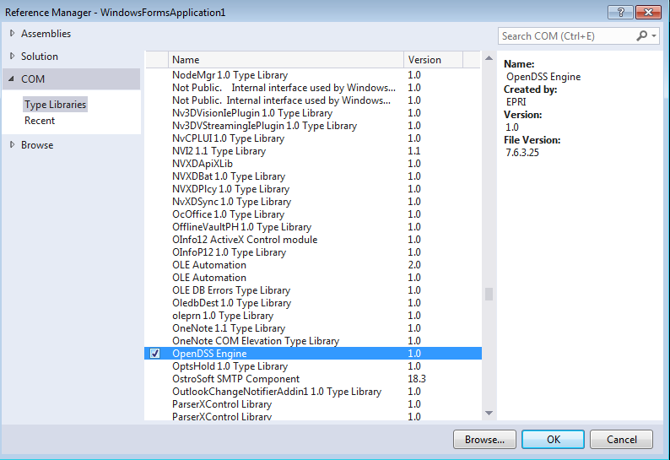
Choose OpenDSSEngine from the List …

Slide 143
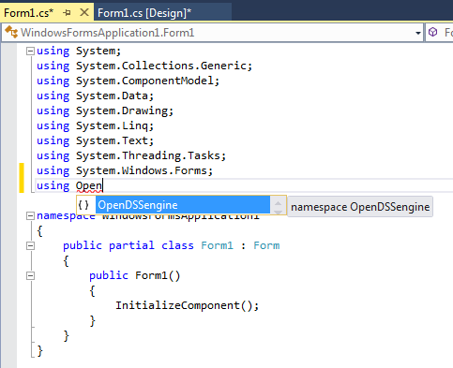
Add “using” clause in Code View ..
You will get a helpful hint

Slide 144
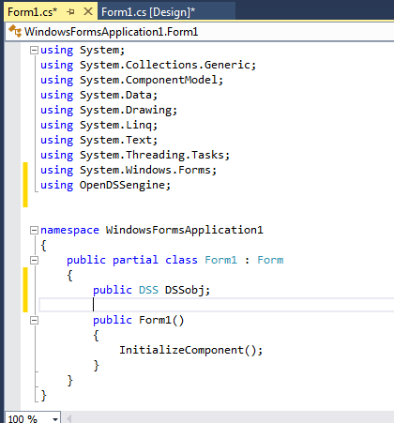
Add Public Variable for DSS object
Type is DSS (the editor will prompt you when you start to type it)
This is the main interface to OpenDSSEngine. The registered interface is “OpenDSSEngine.DSS”

Slide 145
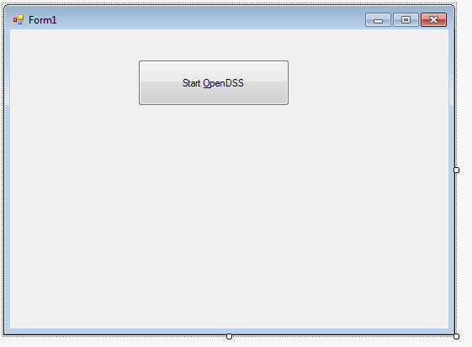
From ToolBox, add a Button the Main Form to Load and Start OpenDSS
Double-Click this to create code for processing button click
Set the Text property of the button control to “Start &OpenDSS”

Slide 146
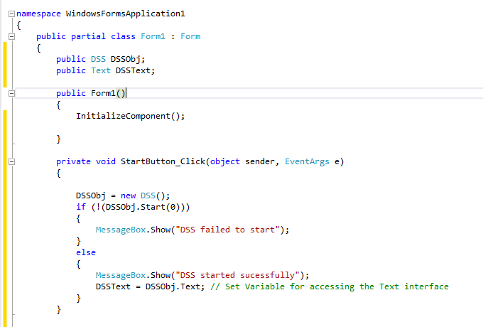
Start OpenDSS and Check if OK
Add public variable for Text interface after OpenDSS starts OK
This is the code generated to handle the button click (named StartButton)
This connects DSSObj variable to the COM server and loads the server
Attempt to start the OpenDSS program
If successful, assign the variable for the Text interface

Slide 147

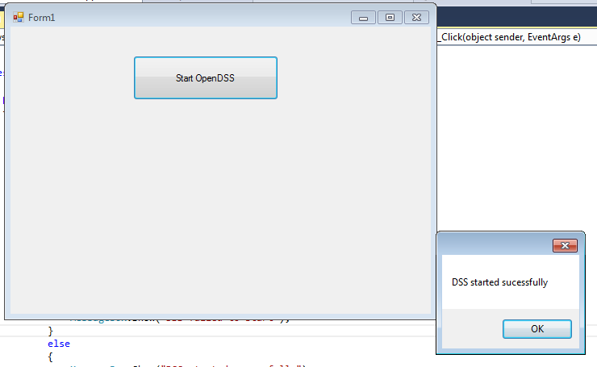
Test it --- Success!
Click Start
Then click this
Now we’re off and running!

Slide 148
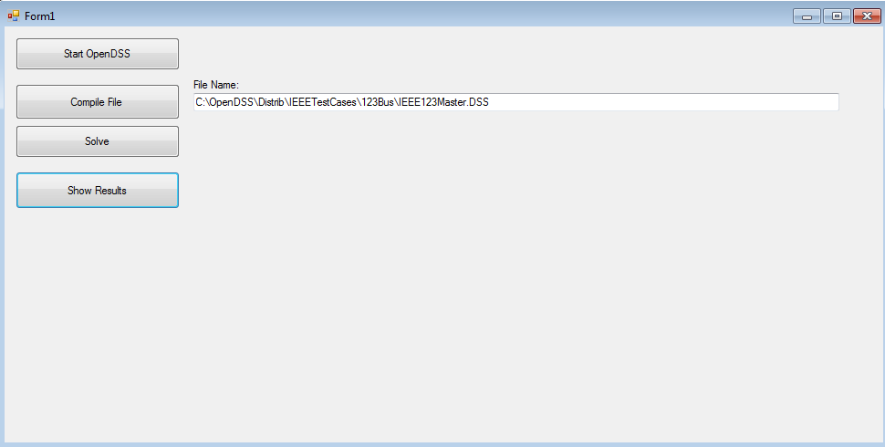
Solve the IEEE 123-Bus Test Feeder
TextBox with full path name of the IEEE123Master.DSS file
Add some stuff to the main form

Slide 149
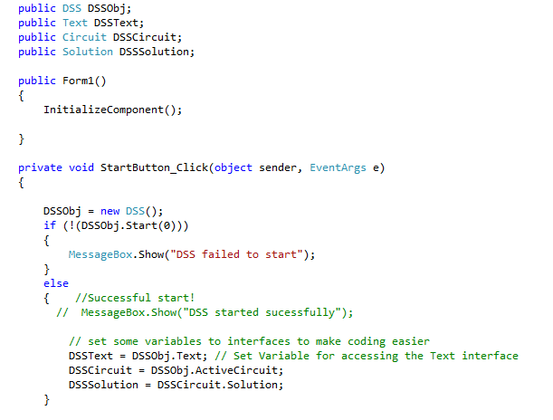
Start Button Code
New Helper Variables
No message on successful start
Set the new variables

Slide 150
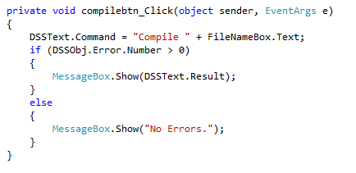
Compile Button Code
Sends Compile command to text interface
Contents of TextBox
Check Error Number on return
If error, show result message
Otherwise show “No Errors.”

Slide 151
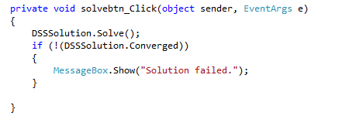
Solve Button Code
Invoke Solve method in Solution interface
Check for lack of convergence

Slide 152
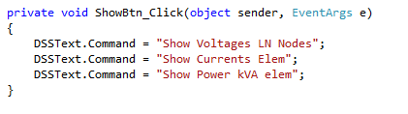
Show Results Button Code
Simply sends three commands to Text interface

Slide 153
What Do You want to Do?
Add other functions to the app or do other C# demos …

Slide 154
A Storage Modeling Example
OpenDSS STORAGE and STORAGECONTROLLER objects

Slide 155
Storage Element Model in OpenDSS
Idle | Discharge | Charge
% Eff. Charge/Discharge
Other Key Properties
% Reserve kWhRated kWhStored %Stored kWRated
etc.
kW, kvar
Idling Losses
kWh STORED

Slide 156
StorageController Element in OpenDSS
Time + Discharge rate Peak Shaving Load Following Loadshape
Discharge Mode Charge Mode kW Target Discharge Time Total Fleet kW Capacity Total Fleet kWh
et. al.
Comm Link
V, I
Substation
Storage “Fleet”

Slide 157
Simple Peak Shave Example – 75 kWh ea.

Slide 158
Simple Peak Shave Example – 25 kWh ea.
“Ran Out of Gas”

Slide 159
Simple Storage Script Using a DynaDLL
Clear
New Circuit.SimpleStore ! Creates voltage source (Vsource.Source)
Edit Vsource.Source BasekV=115 pu=1.02 ISC3=30000 ISC1=25000 !Define source V and Z
New Transformer.TR1 XHL=10
~ Buses=[SourceBus, Sub_Bus]
~ Conns=[Delta Wye]
~ kVs= [115 12.47]
~ kVAs=[200000 200000]
New Linecode.336ACSR R1=0.058 X1=.1206 R0=.1784 X0=.4047 C1=3.4 C0=1.6 Units=kft
New Line.LINE1 Bus1=Sub_Bus Bus2=LoadBus Linecode=336ACSR Length=0.011 Units=Mi
New Transformer.MVLV XHL = 5
~ Buses=[LoadBus LVBus]
~ Conns=[Delta Wye]
~ kVs= [12.47 .400]
~ kVAs=[300 300]
New Storage.Store1 phases=3 Bus1=LVBus kV=0.400 conn=Delta kVA=60
~ kWrated=60 kWHrated= 0.20833 %reserve=50 // 750 kW-s (kJ)
~ state=discharge
~ kW=50 PF=1
~ DynaDLL="C:\Users\prdu001\OpenDSS\Source\DESS1\Dess1.DLL"
~ DynaData=(file=DESSModel_Test.Txt)
// New Load.LOAD1 Bus1=LoadBus kV=12.47 kW=1000 PF=.95 model=4 cvrwatts=1.2
Solve

Slide 160
Defining a StorageController
Define basic circuit
Compile Master.DSS
Redirect AllocateLoadsandMeters.DSS
BusCoords colfax21_EXP_BUSCOORDS.CSV
BusCoords buscoordsCES.DSS ! COORDINATES OF CES LOCATIONS
Set maxcontroliter=20
! ****** ADD STORAGE, SET TO DISCHARGE AND SOLVE ***************************
redirect CES.DSS
! define storage controller
! discharge = load follow ! charge=time
New StorageController.CESmain element=line.568_4921721 terminal=1
~ kWTarget=8000 PFTarget=0.98 %ratecharge=30
~ eventlog=y
New monitor.Store Storage.jo0211000173 1 mode=1 ppolar=no
New monitor.StoreVars Storage.jo0211000173 1 mode=3
solve
Define Storage Fleet
Fleet Controller Default Peakshave Mode @ 8 MW

Slide 161
Snippet of CES.DSS File Defining Storage Fleet
New storage.JO0235001304 phases=1 bus1=X_68_4921721_JO0235001304.1 yearly=Phasealoadshape kV=0.24 kwrated=25 pf=1.0 kwhrated=25 state=IDLING DischargeTrigger=0.8 ChargeTrigger=0.6
New storage.JO0235000257 phases=1 bus1=X_68_4921721_JO0235001304.1 yearly=Phasealoadshape kV=0.24 kwrated=25 pf=1.0 kwhrated=25 state=IDLING DischargeTrigger=0.8 ChargeTrigger=0.6
New storage.JO0235000265 phases=1 bus1=X_43_4921721_JO0235000258.1 yearly=Phasealoadshape kV=0.24 kwrated=25 pf=1.0 kwhrated=25 state=IDLING DischargeTrigger=0.8 ChargeTrigger=0.6
New storage.JO0235000268_1 phases=1 bus1=X_608_4921721_JO0235000273.1 yearly=Phasealoadshape kV=0.24 kwrated=25 pf=1.0 kwhrated=25 state=IDLING DischargeTrigger=0.8 ChargeTrigger=0.6
New storage.JO0235000268_2 phases=1 bus1=X_608_4921721_JO0235000273.1 yearly=Phasealoadshape kV=0.24 kwrated=25 pf=1.0 kwhrated=25 state=IDLING DischargeTrigger=0.8 ChargeTrigger=0.6
New storage.JO0235000269_1 phases=1 bus1=X_608_4921721_JO0235000273.1 yearly=Phasealoadshape kV=0.24 kwrated=25 pf=1.0 kwhrated=25 state=IDLING DischargeTrigger=0.8 ChargeTrigger=0.6
New storage.JO0235000269_2 phases=1 bus1=X_608_4921721_JO0235000273.1 yearly=Phasealoadshape kV=0.24 kwrated=25 pf=1.0 kwhrated=25 state=IDLING DischargeTrigger=0.8 ChargeTrigger=0.6
New storage.JO0235000272_1 phases=1 bus1=X_608_4921721_JO0235000273.1 yearly=Phasealoadshape kV=0.24 kwrated=25 pf=1.0 kwhrated=25 state=IDLING DischargeTrigger=0.8 ChargeTrigger=0.6
New storage.JO0235000272_2 phases=1 bus1=X_608_4921721_JO0235000273.1 yearly=Phasealoadshape kV=0.24 kwrated=25 pf=1.0 kwhrated=25 state=IDLING DischargeTrigger=0.8 ChargeTrigger=0.6
New storage.JO0235000274 phases=1 bus1=X_611_4921721_JO0235000274.1 yearly=Phasealoadshape kV=0.24 kwrated=25 pf=1.0 kwhrated=25 state=IDLING DischargeTrigger=0.8 ChargeTrigger=0.6
New storage.JO0235000583 phases=1 bus1=X_111_4921721_JO0235000585.1 yearly=Phasealoadshape kV=0.24 kwrated=25 pf=1.0 kwhrated=25 state=IDLING DischargeTrigger=0.8 ChargeTrigger=0.6
New storage.JO0235001512 phases=1 bus1=X_470_4921721_JO0235000552.1 yearly=Phasealoadshape kV=0.24 kwrated=25 pf=1.0 kwhrated=25 state=IDLING DischargeTrigger=0.8 ChargeTrigger=0.6
New storage.JO0235000618 phases=1 bus1=X_637_4921721_JO0235000563.1 yearly=Phasealoadshape kV=0.24 kwrated=25 pf=1.0 kwhrated=25 state=IDLING DischargeTrigger=0.8 ChargeTrigger=0.6
New storage.JO0235000593 phases=1 bus1=X_526_4921721_JO0235000559.3 yearly=Phasecloadshape kV=0.24 kwrated=25 pf=1.0 kwhrated=25 state=IDLING DischargeTrigger=0.8 ChargeTrigger=0.6
- - - - -
- - - - -

Slide 162
Introduction to OpenDSS Internals
How it works. A tour of the source code. A look at DLL interfaces.

Slide 163
DSS Object Structure
DSS Executive
Commands
Options
Circuit
Solution
V
[Y]
I
PDElement
PCElement
Controls
Meters
General
Line Transformer Capacitor Reactor
Load Generator Vsource Isource Storage
…
RegControl CapControl Relay Reclose Fuse
Monitor EnergyMeter Sensor
LineCode LineGeometry WireData LoadShape GrowthShape Spectrum TCCcurve XfmrCode

Slide 164
DSS Class Structure
Instances of Objects of this class
Class
Object 1
Property Definitions
Property Values
Methods
Class Property Editor
Yprim
Collection Manager
States
Object n
Property Values
Methods
Yprim
States

Slide 165
Solution Object (Solution.pas)
TNodeVarray = Array[0..1000] of Complex;
pNodeVarray = ^TNodeVarray;
TSolutionObj = class(TDSSObject)
private
dV :pNodeVArray; // Array of delta V for Newton iteration
FFrequency:Double;
FUNCTION Converged:Boolean;
FUNCTION OK_for_Dynamics(const Value:Integer):Boolean;
FUNCTION OK_for_Harmonics(const Value:Integer):Boolean;
Function SolveSystem(V:pNodeVArray):Integer;
PROCEDURE AddInAuxCurrents(SolveType:Integer);
PROCEDURE DoNewtonSolution;
PROCEDURE DoNormalSolution;
PROCEDURE GetPCInjCurr;
PROCEDURE GetSourceInjCurrents;
procedure Set_Frequency(const Value: Double);
PROCEDURE Set_Mode(const Value: Integer);
procedure Set_Year(const Value: Integer);
PROCEDURE SetGeneratordQdV;
PROCEDURE SumAllCurrents;
PROCEDURE ZeroInjCurr;
public
Algorithm :Integer; // NORMALSOLVE or NEWTONSOLVE
AuxCurrents :pComplexArray; // For injections like AutoAdd
ControlActionsDone :Boolean;
ControlIteration :Integer;
ControlMode :Integer; // EVENTDRIVEN, TIMEDRIVEN
ConvergenceTolerance :Double;
ConvergedFlag:Boolean;
DefaultControlMode :Integer; // EVENTDRIVEN, TIMEDRIVEN
DefaultLoadModel :Integer; // 1=POWERFLOW 2=ADMITTANCE
DoAllHarmonics : Boolean;
DynamicsAllowed :Boolean;
DynaVars:TDynamicsRec;
ErrorSaved :pDoubleArray;
FirstIteration :Boolean;
FrequencyChanged:Boolean; // Flag set to true if something has altered the frequency
Fyear :Integer;
Harmonic :Double;
HarmonicList :pDoubleArray;
HarmonicListSize :Integer;
hYsystem :LongWord; {Handle for main (system) Y matrix}
hYseries :LongWord; {Handle for series Y matrix}
hY :LongWord; {either hYsystem or hYseries}
IntervalHrs:Double; // Solution interval since last solution, hrs.

Slide 166
Solution Object – Key Variables
IsDynamicModel :Boolean;
IsHarmonicModel :Boolean;
Iteration :Integer;
LoadModel :Integer; // 1=POWERFLOW 2=ADMITTANCE
LastSolutionWasDirect :Boolean;
LoadsNeedUpdating :Boolean;
MaxControlIterations :Integer;
MaxError :Double;
MaxIterations :Integer;
MostIterationsDone :Integer;
NodeVbase :pDoubleArray;
NumberOfTimes :Integer; // Number of times to solve
PreserveNodeVoltages:Boolean;
RandomType :Integer; //0 = none; 1 = gaussian; 2 = UNIFORM
SeriesYInvalid :Boolean;
SolutionCount :Integer; // Counter incremented for each solution
SolutionInitialized :Boolean;
SystemYChanged :Boolean;
UseAuxCurrents :Boolean;
VmagSaved :pDoubleArray;
VoltageBaseChanged :Boolean;
{Voltage and Current Arrays}
NodeV :pNodeVArray; // Main System Voltage Array
allows NodeV^[0]=0
Currents :pNodeVArray; // Main System Currents Array

Slide 167
Solution Object -- Public Functions and Properties
PROCEDURE ZeroAuxCurrents;
FUNCTION SolveZeroLoadSnapShot :Integer;
PROCEDURE DoPFLOWsolution;
PROCEDURE Solve; // Main Solution dispatch
PROCEDURE SnapShotInit;
FUNCTION SolveSnap:Integer; // solve for now once
FUNCTION SolveDirect:Integer; // solve for now once, direct solution
FUNCTION SolveYDirect:Integer; // Similar to SolveDirect; used for initialization
FUNCTION SolveCircuit:Integer; // SolveSnap sans control iteration
PROCEDURE CheckControls; // Snapshot checks with matrix rebuild
PROCEDURE SampleControlDevices;
PROCEDURE DoControlActions;
PROCEDURE Sample_DoControlActions; // Sample and Do
PROCEDURE Check_Fault_Status;
PROCEDURE SetGeneratorDispRef;
PROCEDURE SetVoltageBases;
PROCEDURE SaveVoltages;
PROCEDURE UpdateVBus; // updates voltages for each bus from NodeV
PROCEDURE RestoreNodeVfromVbus; // opposite of updatebus
FUNCTION VDiff(i,j:Integer):Complex; // Difference between two node voltages
PROCEDURE InitPropertyValues(ArrayOffset:Integer);Override;
PROCEDURE DumpProperties(Var F:TextFile; Complete:Boolean); Override;
PROCEDURE WriteConvergenceReport(const Fname:String);
PROCEDURE Update_dblHour;
PROCEDURE Increment_time;
// set the Mode
Property Mode :Integer Read dynavars.SolutionMode Write Set_Mode;
// Solution Frequency
Property Frequency :Double Read FFrequency Write Set_Frequency;
// Year for multiyear solutions
Property Year :Integer Read FYear Write Set_Year;

Slide 168
Adding a New Model
Create a Delphi unit (.pas file) with a unique name for example MyModel.
Use an existing unit as a pattern.
Collection manager of class TMyModel
Has class Edit function
Assigns the Class_Name variable = ‘MyModel’
Object model of class TmModelObj
Add MyModel to the Uses clause of DSSClassDefs.pas
Add a statement to Create the class:
DSSClasses.New := TMyModel.Create;
OpenDSS now recognizes the class and will pass property definition strings to the Edit function to process

Slide 169
The Edit Function
When you write this script:
New MyModel.ThisInstance phases=3 kV=100 …
This makes a new instance of the objects and invokes the MyModel Edit Function
Everything out here is passed to the MyModel Edit function
(The Edit command tries to find an existing instance of this class of object)

Slide 170
The Edit Function
The author of the model can write whatever code he/she chooses to process the property data.
The standard models use the CASE statement and “TCommandList” class to process properties
In the base “TDSSClass” and is part of all objects
Write the DefineProperties procedure
Use an existing element such as Capacitor as a pattern
You can add properties as you see fit
Define PropertyHelp array so help string will automatically show up in the Help menu
Note: The Edit function operates on the Active element

Slide 171
The Edit Function
VAR
ParamPointer:Integer;
ParamName:String;
Param:String;
BEGIN
Result := 0;
// continue parsing with contents of Parser
ActiveCapacitorObj := ElementList.Active;
ActiveCircuit.ActiveCktElement := ActiveCapacitorObj; // use property to set this value
WITH ActiveCapacitorObj DO BEGIN
ParamPointer := 0;
ParamName := Parser.NextParam;
Param := Parser.StrValue;
WHILE Length(Param)>0 DO BEGIN
IF Length(ParamName) = 0 THEN Inc(ParamPointer)
ELSE ParamPointer := CommandList.GetCommand(ParamName);
If (ParamPointer>0) and (ParamPointer<=NumProperties)
Then PropertyValue[ParamPointer]:= Param;
ParamName := Parser.NextParam;
Param := Parser.StrValue;
END;
Iterate through property names found on script line
Main Case Statement Processes Each Property
CASE ParamPointer OF
0: DoSimpleMsg('Unknown parameter "'+ParamName+'" for Object "Capacitor.'+Name+'"', 450);
1: CapSetbus1(param);
2: Setbus(2, param);
3:{ Numphases := Parser.IntValue}; // see below
4: InterpretDblArray (Param, FNumSteps, FkvarRating);
5: kvRating := Parser.Dblvalue;
… etc…
ELSE
// Inherited Property Edits
ClassEdit(ActiveCapacitorObj, ParamPointer - NumPropsThisClass)
END;

Slide 172
Command and Option Processing
Commands and Options are processed using the same technique as the Edit function
The CASE statement format is used throughout the program
All commands are implemented in text in this manner first
This structure allows new commands and options to be added without disturbing the rest of the program
Likewise, new properties can be added to device models without much fear of breaking previous properties

Slide 173
Basic Functions in a Device Model (Required)
DefineProperties
MakeLike
Create/Destroy constructors/destructors
Edit
Init
NewObject
RecalcElementData
CalcYPrim (for PC and PD elements)
InitPropertyValues
GetPropertyValue (important for editing and displays)
DumpProperties

Slide 174
Classes in a Device Model
TMyModel
Support for Edit function
Define properties, manage collection
TMyModelObj
Private Data and various functions
State variable, parameter values
Local module functions
Public
Variables needed by other modules
Property definitions for accessing private data
Required Functions/Procedures

Slide 175
Together... Shaping the Future of Electricity
(The End)

